Slide 1


DiGi
Share
Droid Rush 2020

Slide 2


HELLO Peers!
Coming Up with a Cross Platform Sharing App, which enable us share large File, Video and also .apk file.
And we can also share files Online.
Here are list of some features of our App :
Nearby Sharing
Share File Though CloudStorage
Share .apk Files
Share in Group

Slide 3
Feature
- Local Sharing
- Cloud Sharing
- Cross Platform Sharing

Slide 4
Local Sharing
1. Local Sharing-
-(P2P) Chatting
- (P2P) File Sharing
-(P2P) App Sharing
- (Group) Files and Apps Sharing

Slide 5
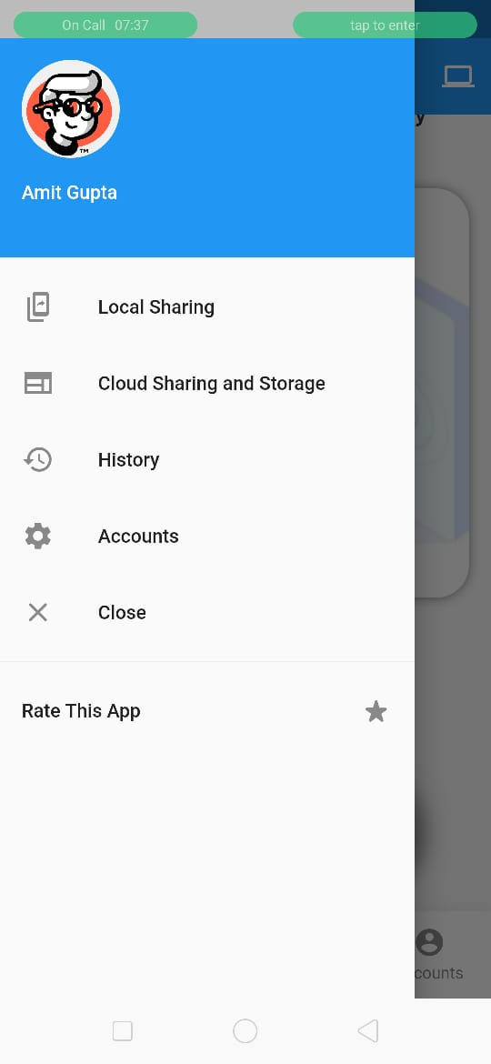
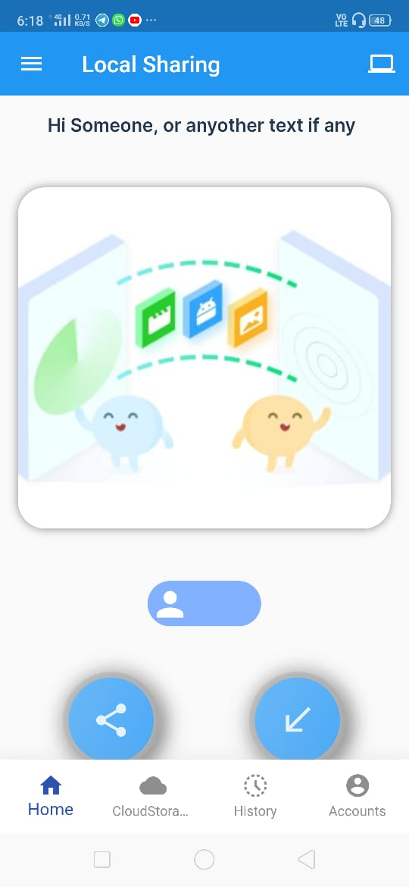
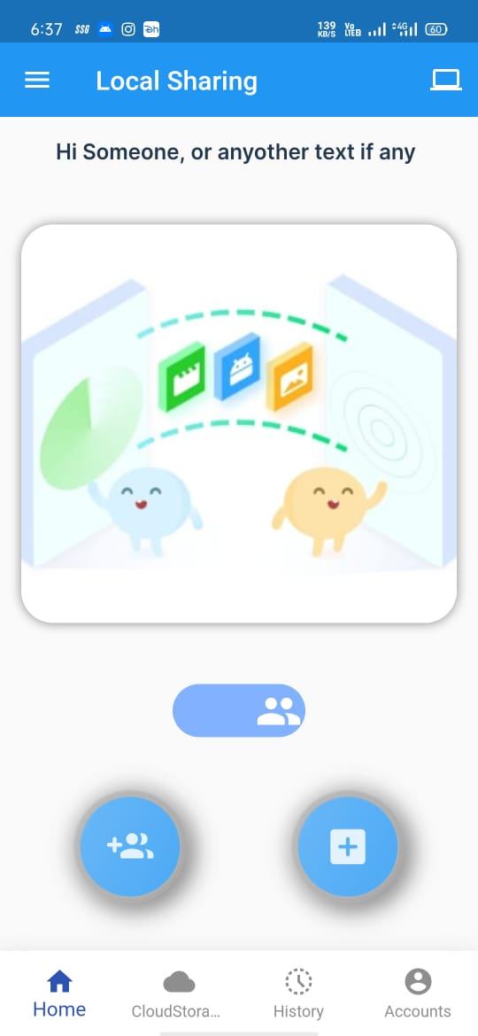

Slide 6
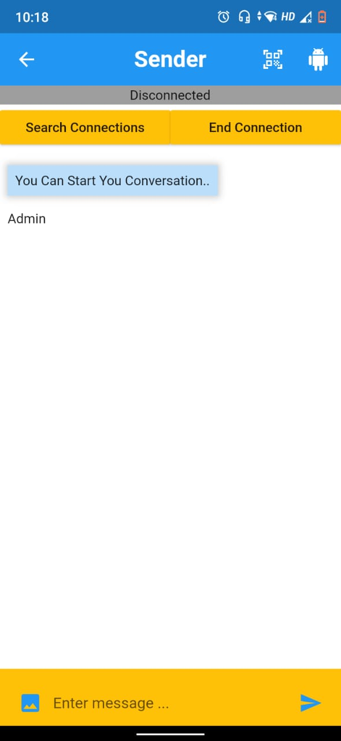
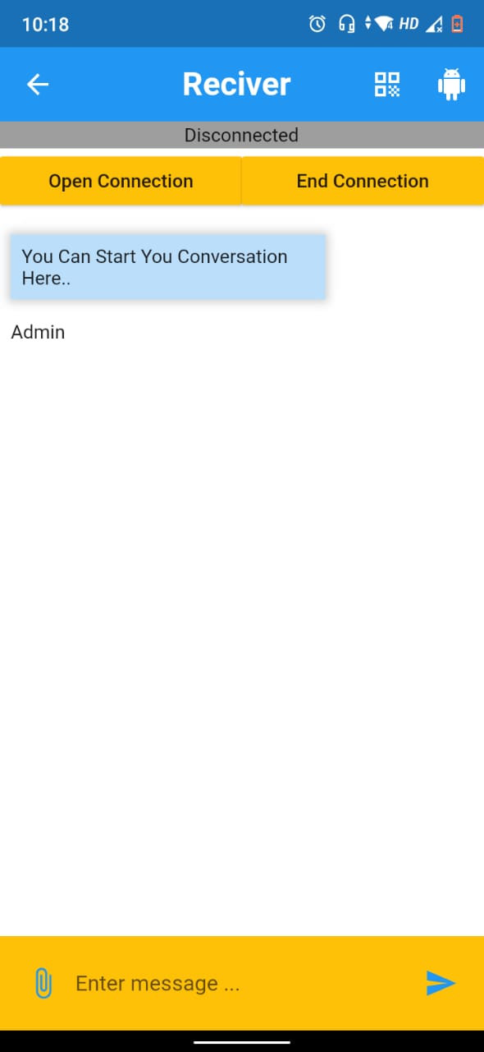
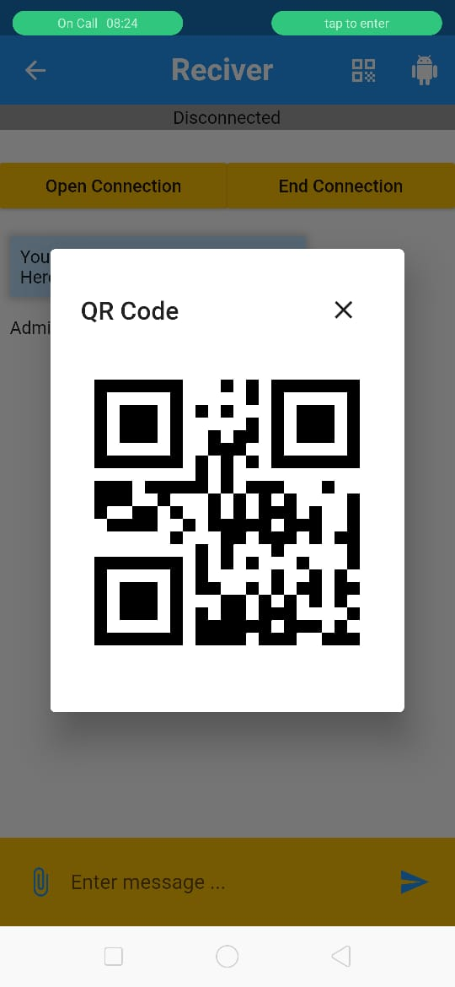

Slide 7
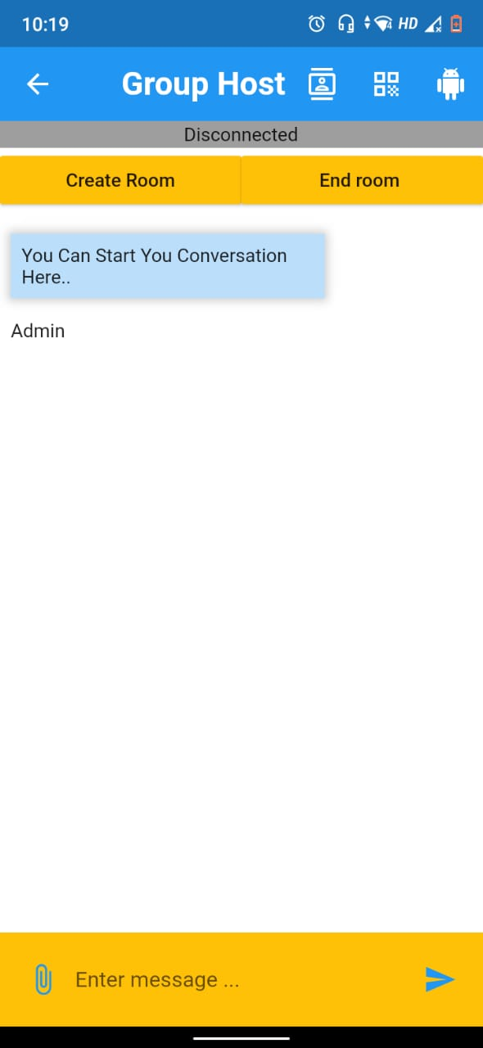
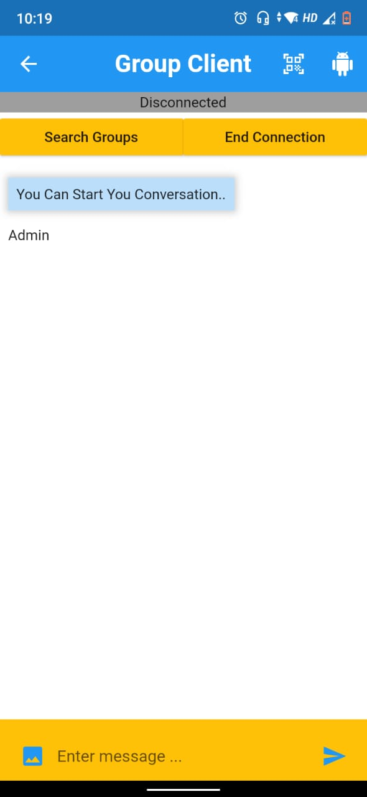

Slide 8
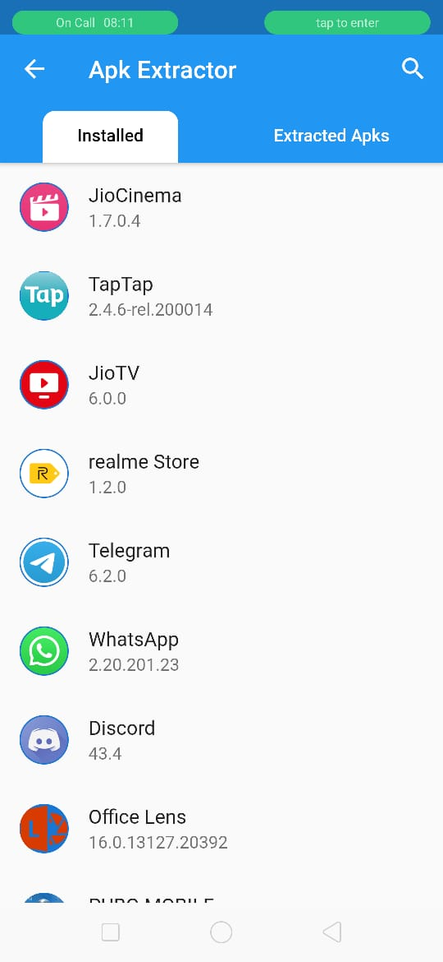
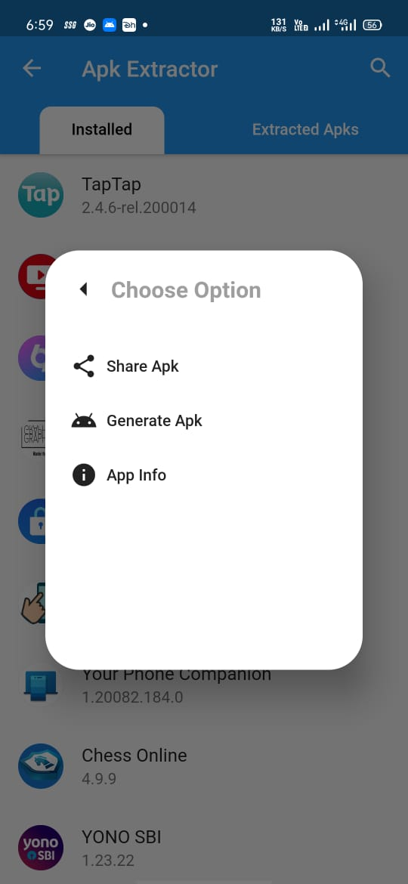

Slide 9
Cloud Sharing
- Authentication (Google, Email-Verification)
- Public Files (Here anyone can upload files by giving the file some tags and anyone search file using tags)
- Private Files (Here You can save your Files privately)
- Share Private Files (By generating key of your private file You can share your private file)

Slide 10
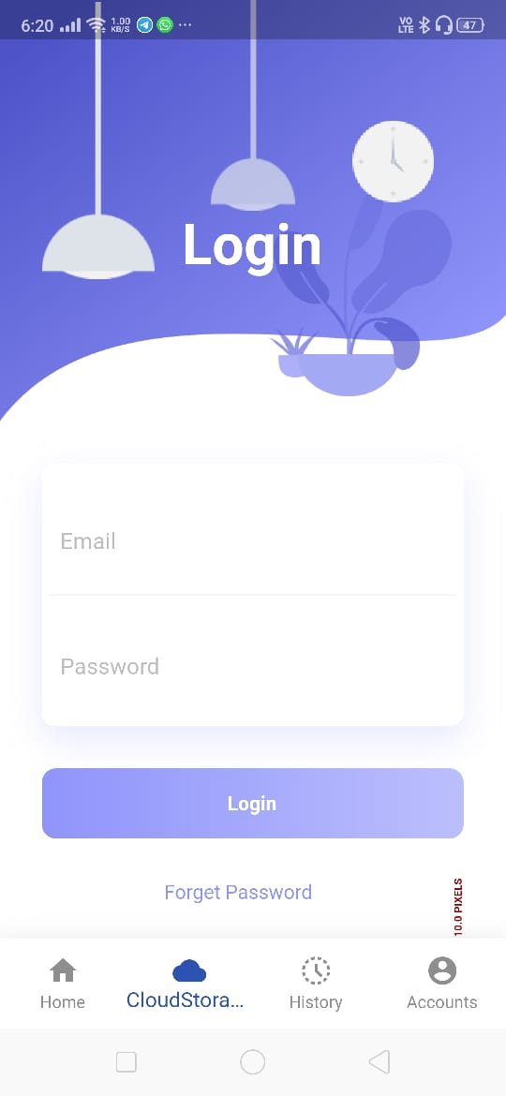
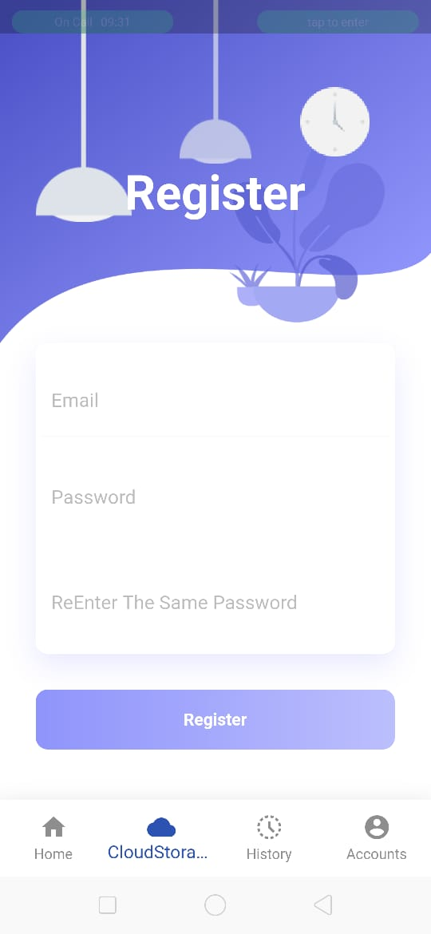

Slide 11
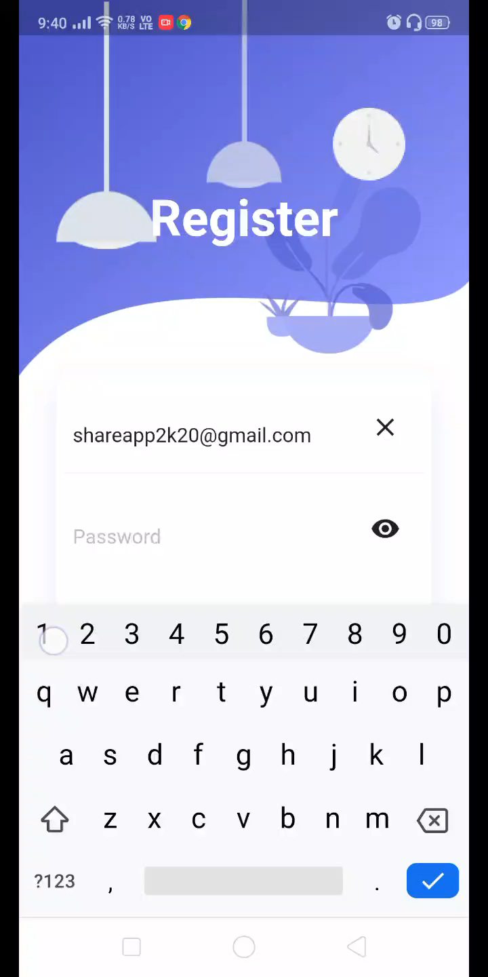

Slide 12
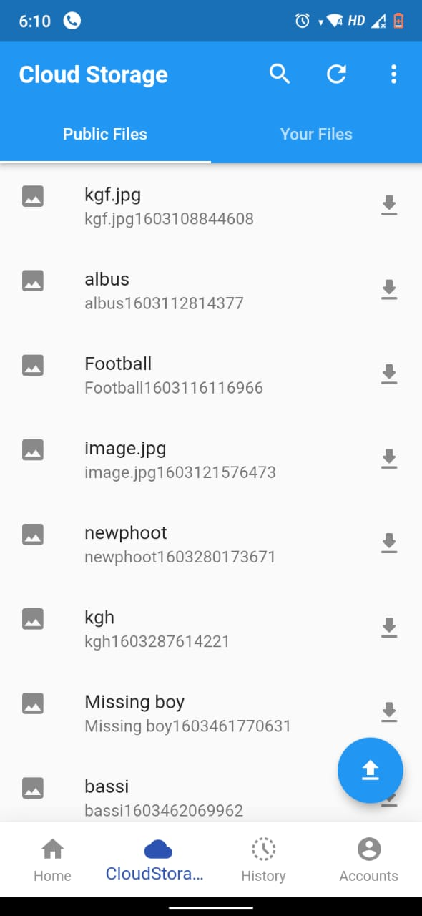
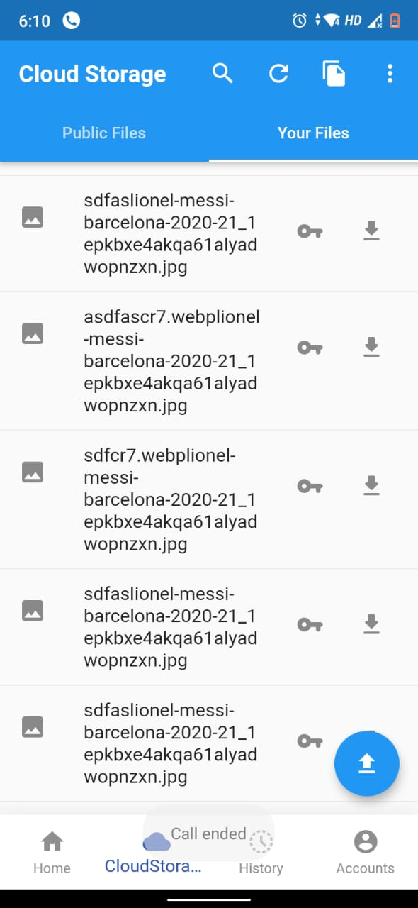

Slide 13
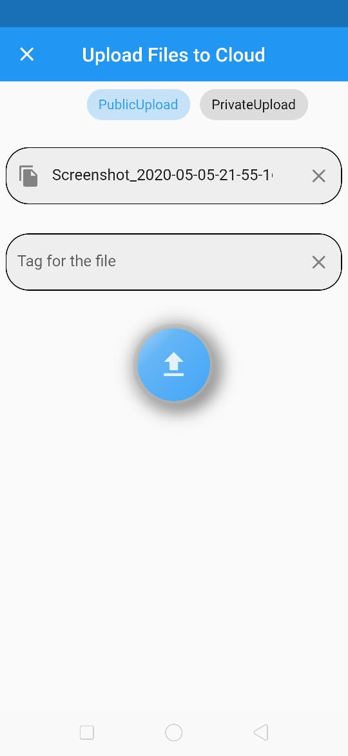
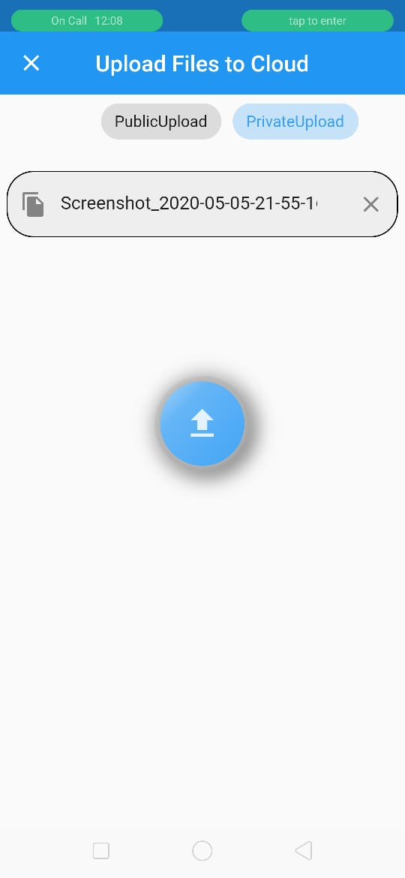

Slide 14
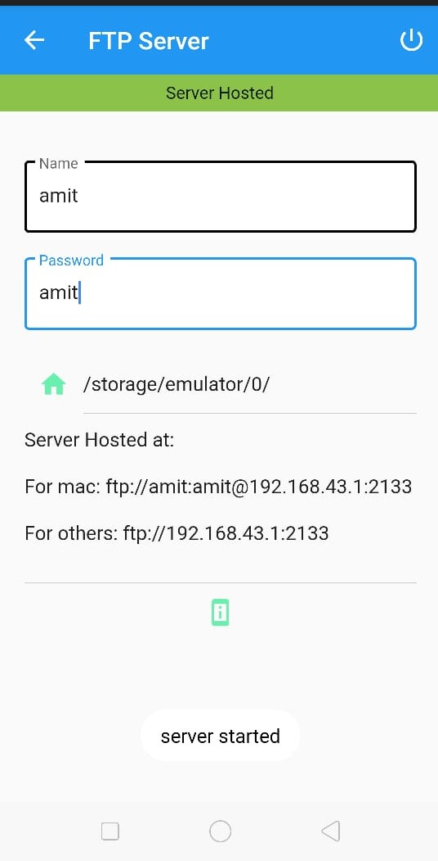
Cross Platform Sharing
Sharing Files From your phone to
devices like Computer
For security Purpose you can add user Name and
Password

Slide 15
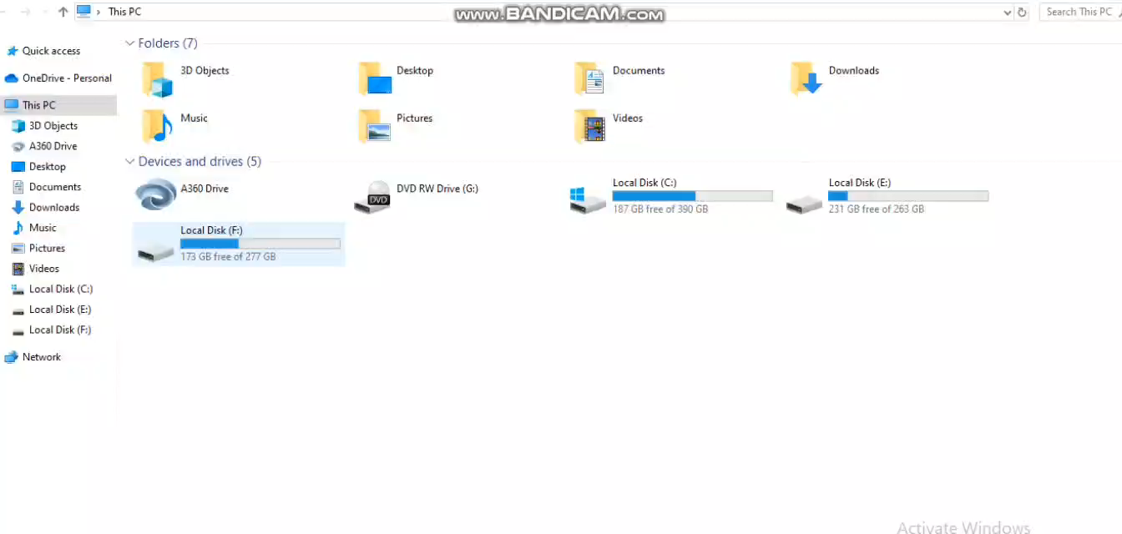

Slide 16
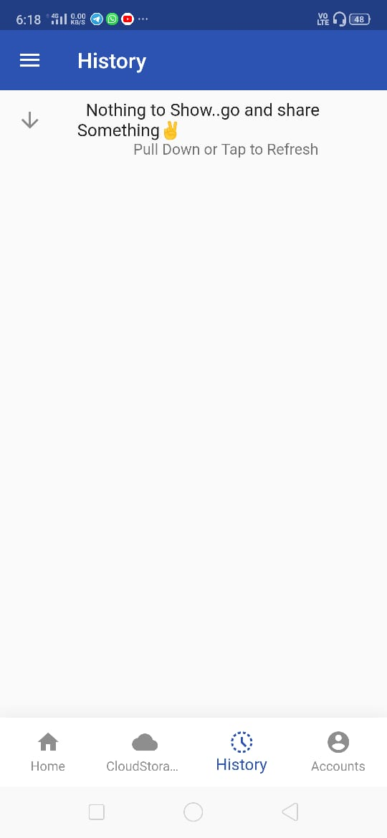
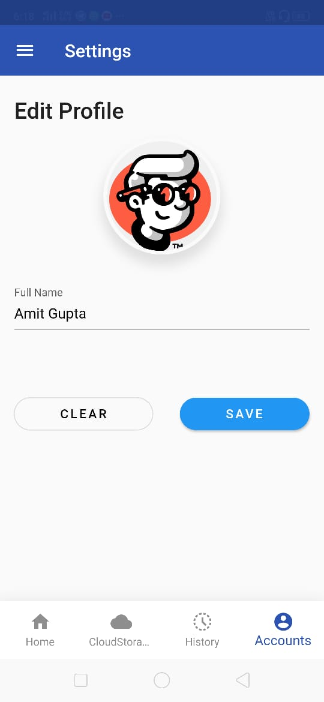
History and Account

Slide 17
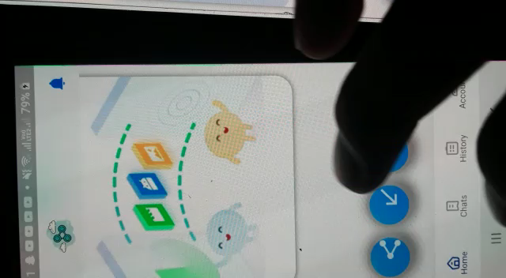
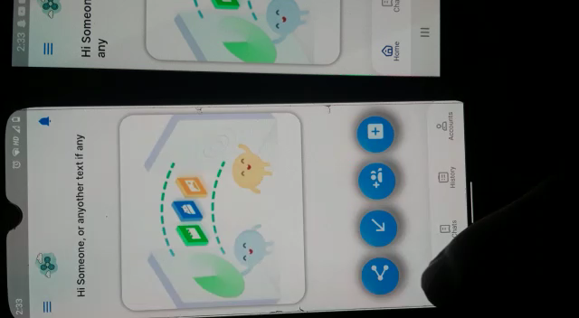

Slide 18
Thank You!

